Slide 1



STOCK PRICE PREDICTION PROJECT

Slide 2
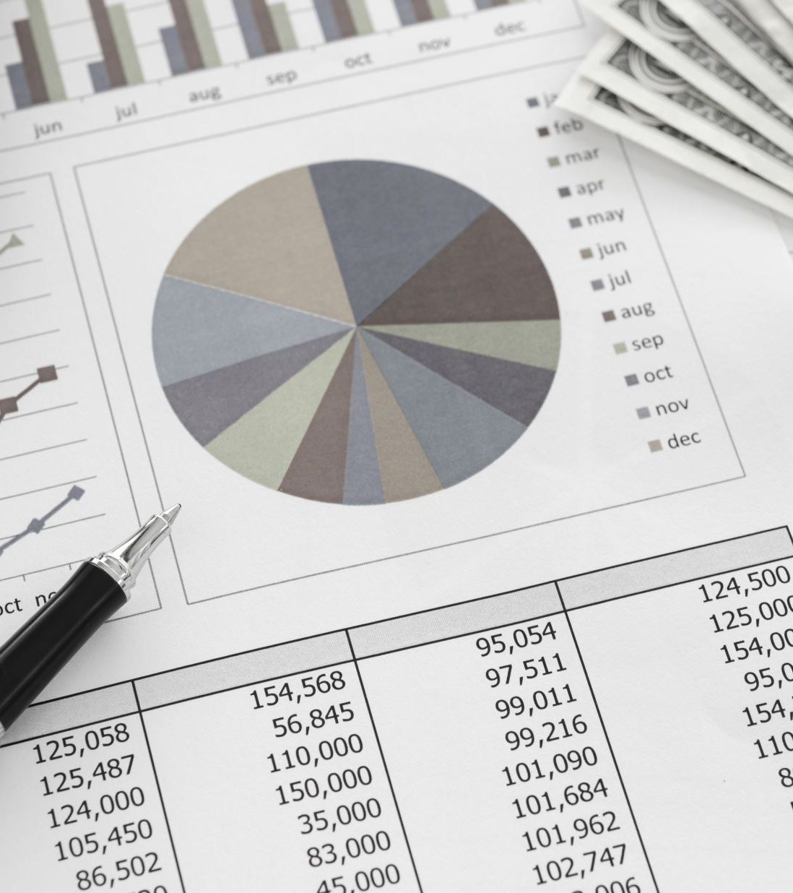
Project Overview:
Our team decided to develop a stock prediction model. We found a rudimentary model that we sought to improve. The original model used historical daily price data for publicly traded companies.

Slide 3

Project Questions
Comparing the Prediction Model from: https://data-flair.training/blogs/stock-price-prediction-machine-learning-project-in-python/ ...
Can we download the snippets of this code, and re-create a working model?
Can we find an API site instead of the CSV file, and create a working model that is always up-to-date?
If we add another industry (like Meme stocks vs Tech stocks), will the model continue to work?
Is there another prediction model that would work better?

Slide 4
Project Steps
Step 1: Pulling data from Yahoo Finance
Step 2: Cleaning the data
Step 3: Connecting PgAdmin and AWS to pull and store data
Step 4: Merge data to new (consolidated) dataframe via SQL
Step 5: Using that data make a model for prediction
Step 6: Create web html and hosting on web
Step 7: Use Tableau to show visualizations
Step 8: Put it all together

Slide 5
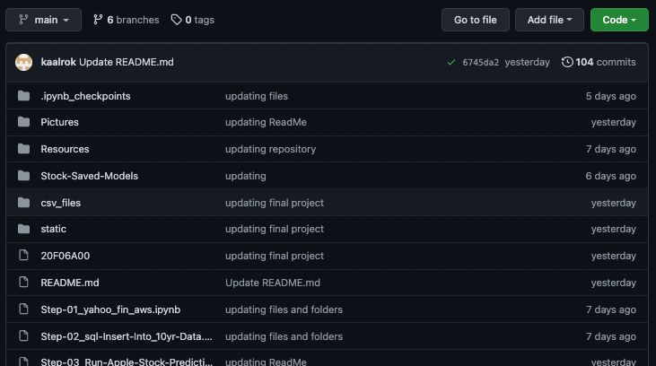
GitHub

Slide 6
Gathering the Data
Python and yahoo_fin
After trying Yahoo Finance RapidAPI we settled on yahoo_fin, a web-scraping tool
Advantages
Built in python library
No API calls i.e. No config files and passwords
Data was mostly structured the way we wanted – less pre-processing for the ML model
Able to get 10 years of data
# pip install yahoo_fin
from yahoo_fin.stock_info import get_data
http://theautomatic.net/yahoo_fin-documentation/

Slide 7

The Code Using VS Code .ipynb Files
# Import dependencies
import pandas as pd
import matplotlib.pyplot as plt
from sqlalchemy import create_engine
from config import db_password
from sqlalchemy import create_engine
import psycopg2
import time
# pip install yahoo_fin
from yahoo_fin.stock_info import get_data

Slide 8
tickers = ['amzn', 'MSFT', 'FB', "aapl", "GME", "TSLA", "GOOGL"]
start_date = "01/01/2012"
end_date = "12/31/2021"
for ticker in tickers:
daily = get_data(ticker, start_date=start_date,
end_date=end_date, index_as_date=False, interval="1d")
# Export the dataframe to a csv file
daily.to_csv(f'stockprice_daily_{ticker}.csv', index=False)
print(f'{ticker} dataframe and .csv file created.')

Slide 9
Machine Learning Model - (ML)
Long Short Term Memory (LSTM)
LSTM: best available ML model for handling time series data
Found rudimentary model to use as a starting point
Used Yahoo Finance Library - more flexible and easier than Polygon API
Eliminated preprocessing of data prior to ML data processing
Determined use of date and close in model so used Python code to create a new dataframe
Used MinMaxScaler to scale the new dataframe on the training set to between 0 and 1.
Split data into train and test sets and set at 80% train / 20%
Built and trained model using Sequential function of LSTM

Slide 10

Machine Learning Model - (ML)
Long Short Term Memory (LSTM) - Continued
Continue
built model by determining feature and target
Compile
Compiled the model using mean squared error.
Train and test
Trained and tested the data
Use
Used Prediction function running the model with the test data.

Slide 11
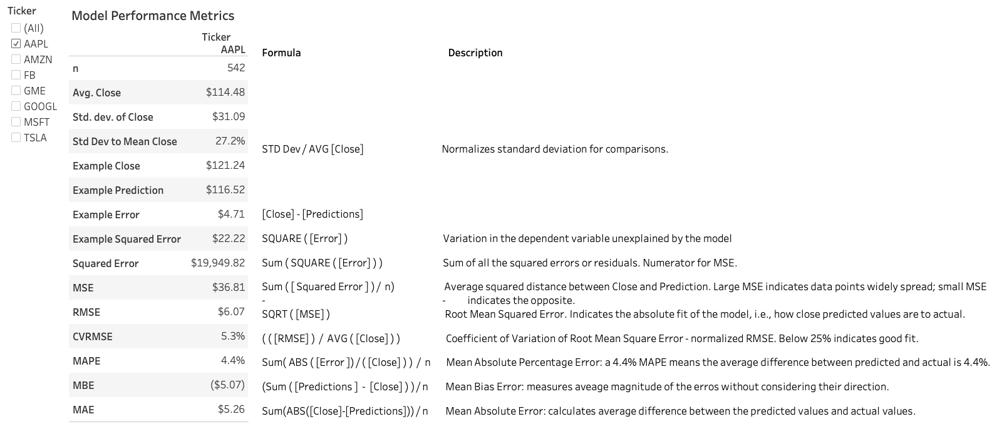
Machine Learning Model Performance Metrics:

Slide 12
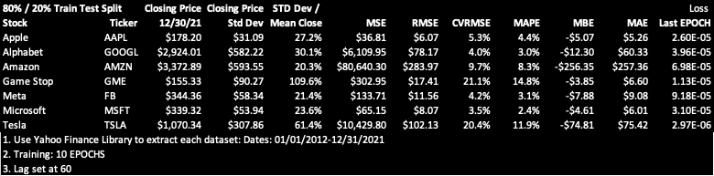
Machine Learning Model Results:

Slide 13
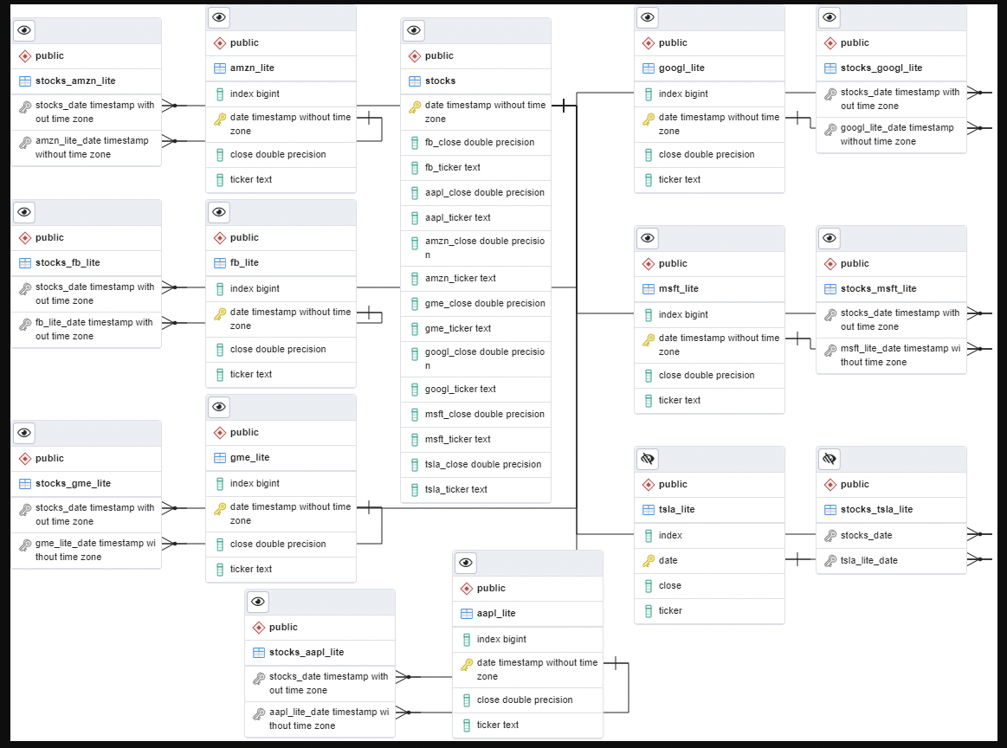
ML ERD:

Slide 14

Displaying the Data Online
We chose GitHub pages because it is easy to set up from our repository
Advantages
Easy set up
Collaborative
Familiar
Disadvantages
Necessitates the use of JavaScript, HTML, and CSS
Unable to run Python Code

Slide 15

Embedded Slides and Vizzes
In order to provide more interactivity, we added Tableau vizzes as well a PowerPoint Slides
Tableau embeds provide a lot of customizations which are sometimes problematic
PowerPoint embedded quite easily with very few customizations
https://tkirk70.github.io/final_project_presentation/

Slide 16
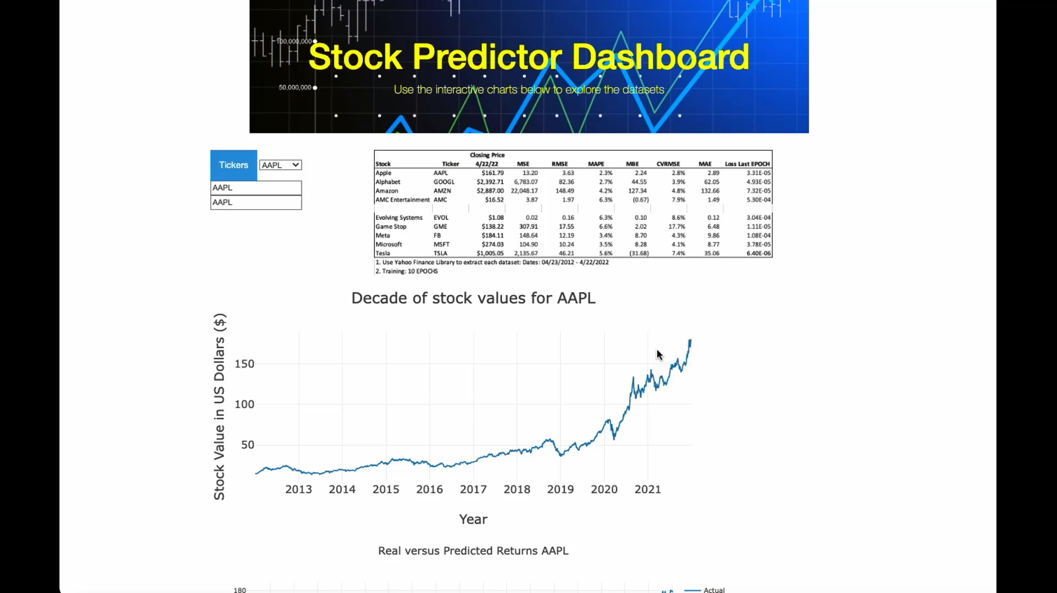
Dashboard

Slide 17
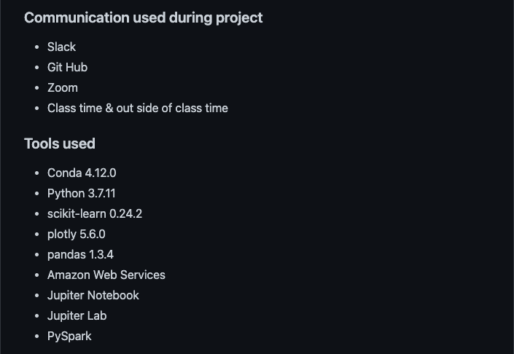
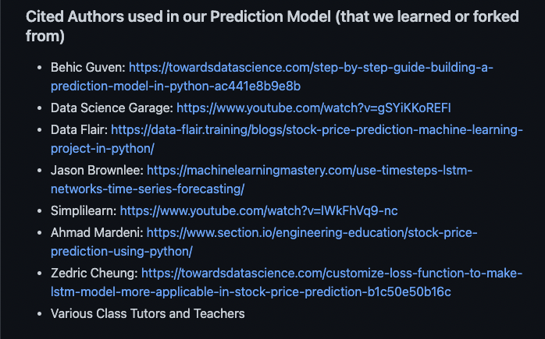
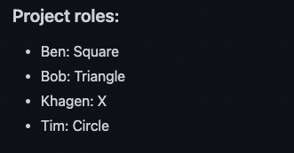
Tools, Reference & Role

Slide 18
Reference:
Cited Authors used in our Prediction Model (that we learned or forked from)
Behic Guven: https://towardsdatascience.com/step-by-step-guide-building-a-prediction-model-in-python-ac441e8b9e8b
Data Science Garage: https://www.youtube.com/watch?v=gSYiKKoREFI
Data Flair: https://data-flair.training/blogs/stock-price-prediction-machine-learning-project-in-python/
Jason Brownlee: https://machinelearningmastery.com/use-timesteps-lstm-networks-time-series-forecasting/
Simplilearn: https://www.youtube.com/watch?v=lWkFhVq9-nc
Ahmad Mardeni: https://www.section.io/engineering-education/stock-price-prediction-using-python/
Zedric Cheung: https://towardsdatascience.com/customize-loss-function-to-make-lstm-model-more-applicable-in-stock-price-prediction-b1c50e50b16c
Various Class Tutors and Teachers
Communication:
Slack
Git Hub
Zoom
Class time & outside of class time
Project Roles:
Ben: Square
Bob: Triangle
Khagen: X
Tim: Circle
Tools:
Conda 4.12.0
Python 3.7.11
scikit-learn 0.24.2
plotly 5.6.0
pandas 1.3.4
Amazon Web Services
Jupiter Notebook
Jupiter Lab
PySpark

Slide 19
Questions?

